Slide 1


Linearly non separable pattern classification
=============================================================================
WWW.THEMLLABS.COM || contact@themllabs.com || Phone : 91-7338339898, 91-6362546088

Slide 2
Agenda
Pattern classification
Linearly separable
Non-linearly separable
Non-linear separable pattern classification
=============================================================================
WWW.THEMLLABS.COM || contact@themllabs.com || Phone : 91-7338339898, 91-6362546088

Slide 3
Pattern classification
Pattern classification is the process of categorizing the data into distinct classes.
Categorization can be distinct labelling of the data, division of the data into classes, selection of the most significant feature of the data or combination of these tasks.
=============================================================================
WWW.THEMLLABS.COM || contact@themllabs.com || Phone : 91-7338339898, 91-6362546088

Slide 4
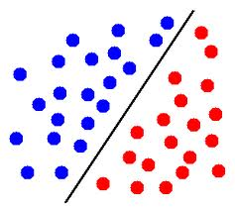
Linearly separable
The hyperplane which separates the two set of points such that one class of points present in one half and another class of points in the second half.
In two dimension, the line will separate the points and in three dimension, the plane will separate the points.
=============================================================================
WWW.THEMLLABS.COM || contact@themllabs.com || Phone : 91-7338339898, 91-6362546088

Slide 5
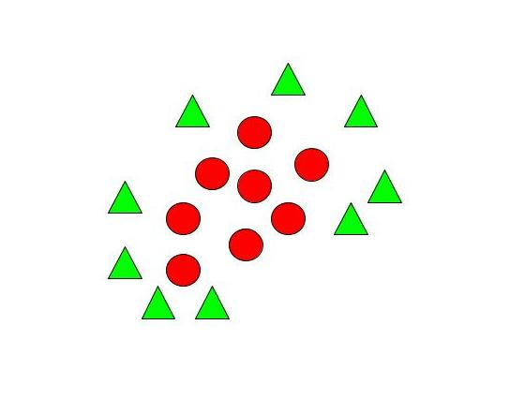
Non-linearly separable
The points which are not separated by straight line or linearly.
The curves, multiple lines or mapping the data into high dimensional space to classify the data.
The figure shown in the right side is the data
which are non-linearly separable. We can use
ellipse to separate the two set of data
=============================================================================
WWW.THEMLLABS.COM || contact@themllabs.com || Phone : 91-7338339898, 91-6362546088

Slide 6
Non-linear separable pattern classification
It is an iterative process, to classify the patterns in non-linear way.
There is no guarantee for convergence. So non-convergence is a common issue.
The algorithm requires initial values
=============================================================================
WWW.THEMLLABS.COM || contact@themllabs.com || Phone : 91-7338339898, 91-6362546088

Slide 7
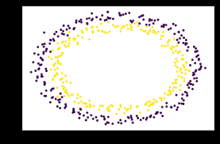
There are multiple minima in the sum of squares.
K-nearest neighbor and kernel SVM are the non-linear classifiers.
=============================================================================
WWW.THEMLLABS.COM || contact@themllabs.com || Phone : 91-7338339898, 91-6362546088

Slide 8
Thank you
=============================================================================
WWW.THEMLLABS.COM || contact@themllabs.com || Phone : 91-7338339898, 91-6362546088

